Slide 1
Sistemas de Ecuaciones No-Lineales
Dr. Luis Sanchez

Slide 2
Objectives
Understanding the fixed-point iteration method for nonlinear equation systems.
Knowing how to solve a roots problem with the Newton-Raphson method for nonlinear equation systems.
Knowing how to solve a roots problem with the Quasi-Newton Methods for nonlinear equation systems.

Slide 3
Systems of Nonlinear Equations
Systems of Nonlinear Equations
Locate the roots of a set of simultaneous nonlinear equations:

Slide 4
Systems of Nonlinear Equations
Example: x² + xy = 10 y + 3xy² = 57
u(x,y) = x²+ xy -10 = 0
v(x,y) = y+ 3xy² -57 = 0
The solution will be the value of x and y which makes u(x,y)=0 and v(x,y)=0
These are x=2 and y=3
Numerical methods used are extension of the open methods for solving single equation; Fixed point iteration and Newton-Raphson.

Slide 5
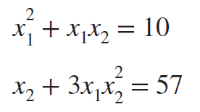
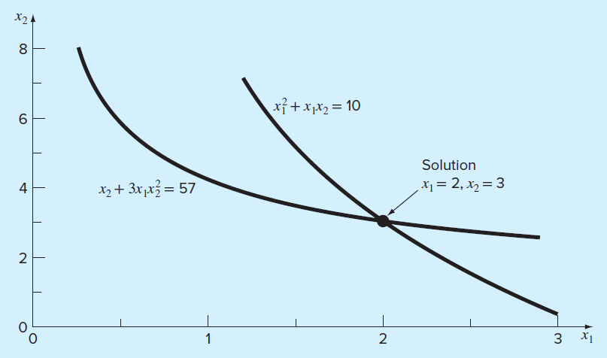
Graphical depiction of the solution of two simultaneous nonlinear equations:

Slide 6
Systems of Nonlinear Equations: 1.Fixed Point Iteration
Use an initial guess x =1.5 and y =3.5
The iteration formula:
x_{i+1}=(10-x_{i}²)/y_{i} and y_{i+1}=57-3x_{i}y_{i}²
First iteration,
x=(10-(1.5)²)/3.5=2.21429
y=(57-3(2.21429)(3.5)²=-24.37516
Second iteration:
x=(10-2.21429²)/-24.37516=-0.209
y=57-3(-0.209)(-24.37516)²=429.709
Solution is diverging so try another iteration formula

Slide 7
Systems of Nonlinear Equations: 1.Fixed Point Iteration
Using iteration formula:
x_{i+1}=(10-x_{i}y_{i})^{1/2} and y_{i+1}=[(57-y_{i})/3x_{i}]^{1/2}
First guess: x=1.5 and y=3.5
1st iteration:
x=(10-(1.5)(3.5))^{1/2}=2.17945
y=((57-(3.5))/3(2.17945))^{1/2}=2.86051
2nd iteration:
x=(10-(2.17945)(2.86051))^{1/2}=1.94053
y=((57-(2.86051))/3(1.94053))^{1/2}=3.04955
The approach is converging to the true root, x=2 and y=3

Slide 8
Systems of Nonlinear Equations: 1.Fixed Point Iteration
The sufficient condition for convergence for the two-equation case (u(x,y)=0 and v(x,y)=0) are:

Slide 9
EXAMPLE: FIXED-POINT ITERATION
Using the fixed-point iteration method in Matlab to solve the nonlinear system:
Solution:

Slide 10
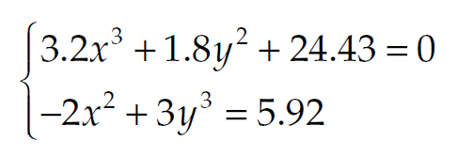
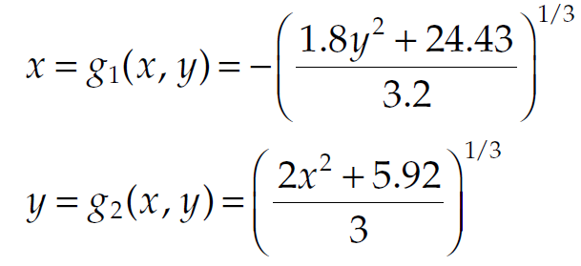
Exercise: FIXED-POINT ITERATION
Using the fixed-point iteration method, solve the nonlinear system:
Solution:
We first need to rewire the given equations by selecting suitable iteration functions. Recall that these iteration functions are not unique. One way to rewrite the original system is:

Slide 11
Systems of Nonlinear Equations: 2. Newton Raphson Method
Recall the standard Newton Raphson formula:
which can be written as the following formula

Slide 12
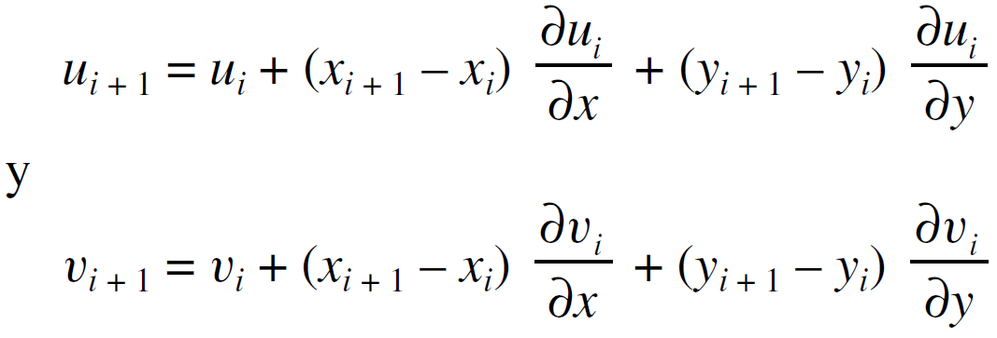
Systems of Nonlinear Equations: 2. Newton Raphson Method
By multi-equation version (in this section we deal only with two equation) the formula can be derived in an identical fashion:
u(x,y)=0 and v(x,y)=0
For the two-variable case, a first-order Taylor series can be written for each nonlinear equation as:

Slide 13
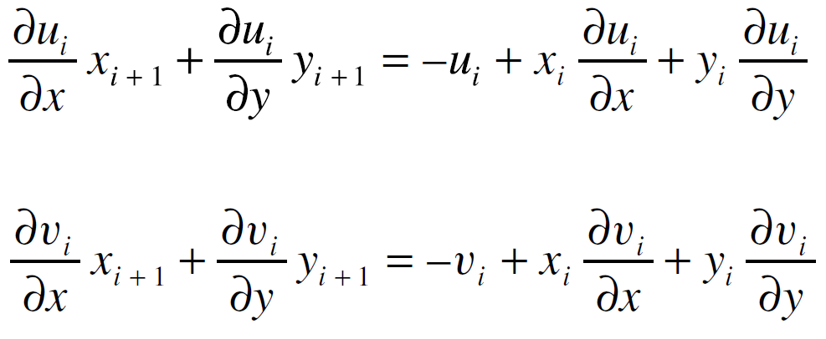
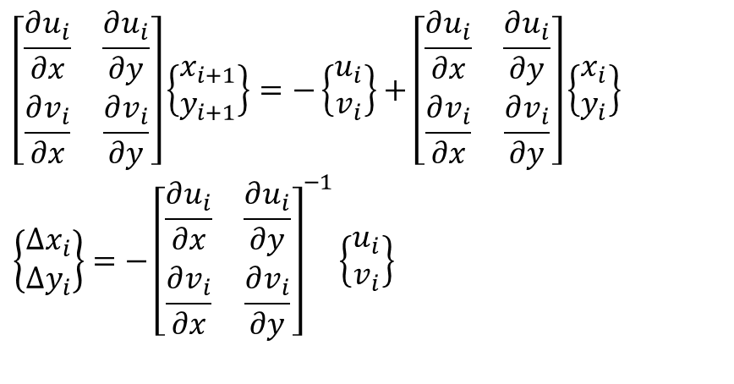
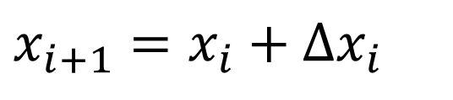
Systems of Nonlinear Equations: 2. Newton Raphson Method
Just as for the single-equation version
$$\left[\begin{matrix}\frac{∂u_{i}}{∂x} & \frac{∂u_{i}}{∂y} \\ \frac{∂v_{i}}{∂x} & \frac{∂v_{i}}{∂y}\end{matrix}\right]\left\{\begin{matrix}x_{i+1} \\ y_{i+1}\end{matrix}\right\}=−\left\{\begin{matrix}u_{i} \\ v_{i}\end{matrix}\right\}+\left[\begin{matrix}\frac{∂u_{i}}{∂x} & \frac{∂u_{i}}{∂y} \\ \frac{∂v_{i}}{∂x} & \frac{∂v_{i}}{∂y}\end{matrix}\right]\left\{\begin{matrix}x_{i} \\ y_{i}\end{matrix}\right\} \\ \left\{\begin{matrix}Δx_{i} \\ Δy_{i}\end{matrix}\right\}=−{\left[\begin{matrix}\frac{∂u_{i}}{∂x} & \frac{∂u_{i}}{∂y} \\ \frac{∂v_{i}}{∂x} & \frac{∂v_{i}}{∂y}\end{matrix}\right]}^{−1}\left\{\begin{matrix}u_{i} \\ v_{i}\end{matrix}\right\}$$
$$x_{i+1}=x_{i}+Δx_{i}$$

Slide 14
Systems of Nonlinear Equations: 2. Newton Raphson Method
And thus

Slide 15
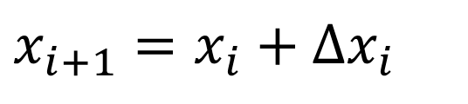
Example
Solve the following system of equations:
$$x_{i+1}=x_{i}+Δx_{i}$$

Slide 16
Solution Using Newton’s Method

Slide 17
Example Try this
Solve the following system of equations:

Slide 18
Example Solution

Slide 19


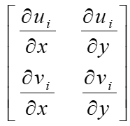


Systems of Nonlinear Equations: 2. Newton Raphson Method
Just as for the single-equation version
$F_{i}$ =
Ji =
$$X_{i+1}=X_{i}− \left[J_{i}\right]−1\{X_{i}\}$$

Slide 20

General Representation for the solution of Nonlinear Systems of Equations
⬅ Jacobian Matrix
Solve this set of linear equations at each iteration:
$X_{i+1}=X_{i}− [J_{i}]$⁻¹$\{X_{i}\}$
{X}_{(i+1)} values are found by solving this system of linear equations.
These iterations will continue until the convergence is reached;
which will happen when the approximate relative error (defined on the vector of values) falls below the desired error tolerance ε_{tol}

Slide 21
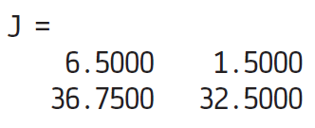
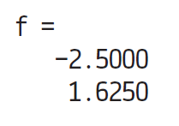
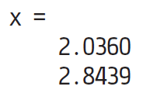
Example 03
Using MATLAB to Solve x² + xy = 10 y + 3xy² = 57
>> x = [1.5;3.5];
>> J = [2*x(1)+x(2) x(1);3*x(2)^2 1+6*x(1)*x(2)];
>> f = [x(1)^2+x(1)*x(2)-10;x(2)+3*x(1)*x(2)^2-57]
>> x = x−J\f

Slide 22
function [x,f,ea,iter]=newtmult(func,x0,es,maxit,varargin)
if nargin<2
error('at least 2 input arguments required');
end
if nargin<3||isempty(es)
es = 0.0001;
end
if nargin<4||isempty(maxit)
maxit = 50;
end
iter = 0;
x=x0;
while (1)
[F,JF] = func(x);
dx = JF\F;
x = x-dx;
iter = iter + 1;
ea=100*max(abs(dx./x));
if iter >= maxit||ea <=es
break;
end
end
end
function [F,JF] = FunctionX(X)
%UNTITLED3 Summary of this function goes here
% Detailed explanation goes here
x1=X(1);
x2=X(2);
F = [x1^2+x1*x2-10;x2+3*x1*x2^2-57];
JF=[2*x1+x2 x1;3*x2^2 1+6*x1*x2];
end

Slide 23
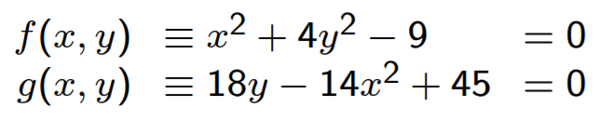
Exercise: Consider solving the system
Use the Newton Raphson method to solve the system

Slide 24
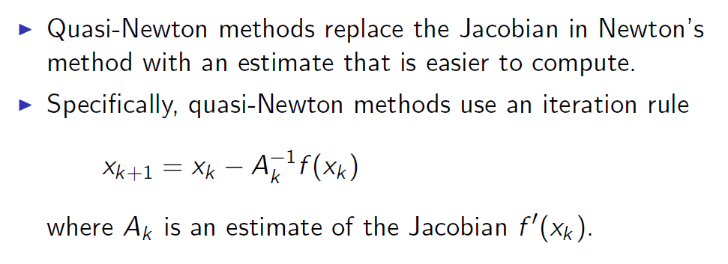
Quasi-Newton Methods

Slide 25
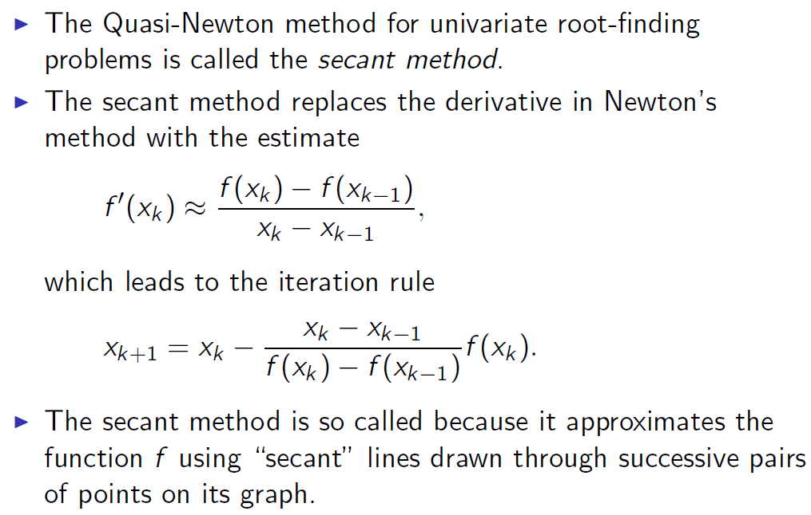
Secant Method

Slide 26
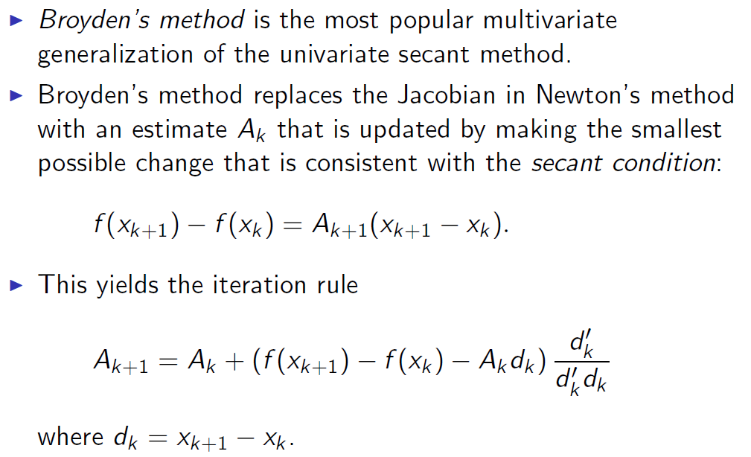
Broyden’s Method

Slide 27
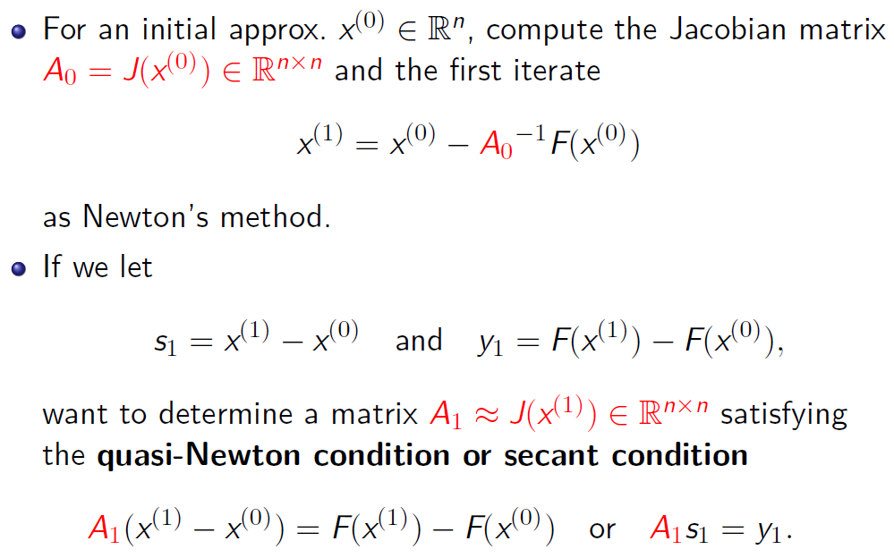
Derivation of Broyden’s Method
(1)

Slide 28
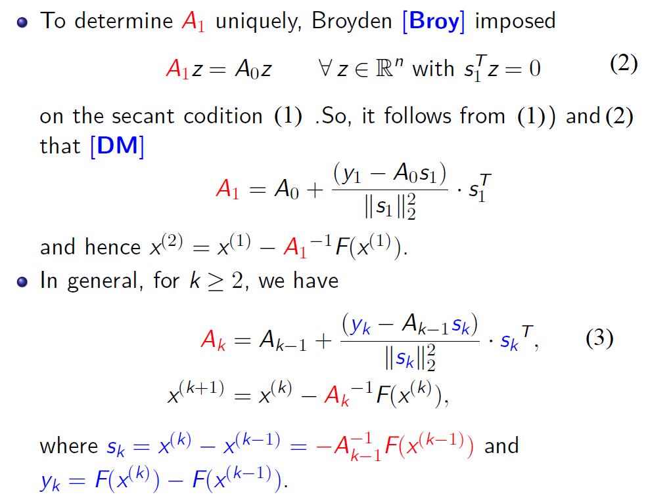
Derivation of Broyden’s Method

Slide 29
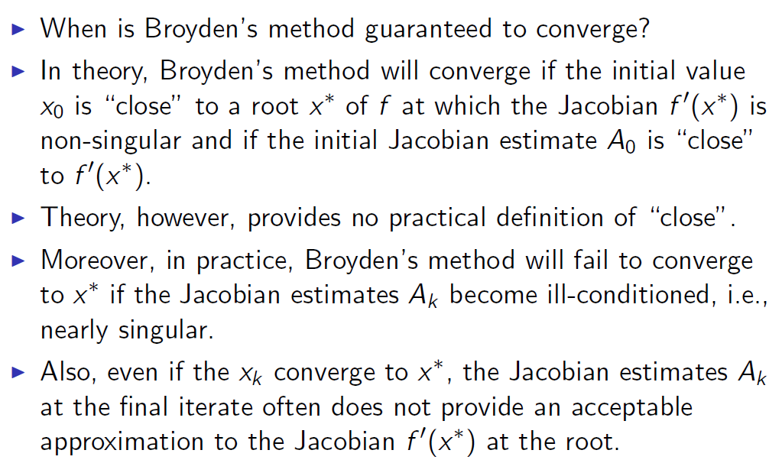

Slide 30
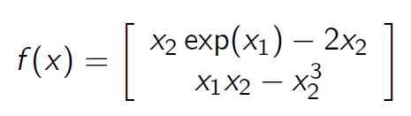
Exercise - Broyden’s method
Compute the root of
Using Broyden’s method.

